Slide 1

SWR302 ASSIGNMENT 1.3
SE1619-NET _ Group 4
Lecture: Chu Thi Minh Hue

Slide 2

mEMBERS

Slide 3
Members
Nguyễn Hữu Tiến Anh (Leader)
Đặng Tất Thành
Đan Công Duy
Nguyễn Minh Đức
Thái Minh Quang

Slide 4
Task of each member
Nguyễn Hữu Tiến Anh:
Record of change
Screen description
User

Slide 5
Task of each member
Đặng Tất Thành:
Screen flow
Class list and detail

Slide 6
Task of each member
Nguyễn Minh Đức:
Non-screen functional
Subject list and detail

Slide 7
Task of each member
Đan Công Duy:
Screen authorization
Login, register

Slide 8
Task of each member
Thái Minh Quang:
Entity Relationship Diagram
Setting

Slide 9

Present detail
Alll of the works our team have done

Slide 10
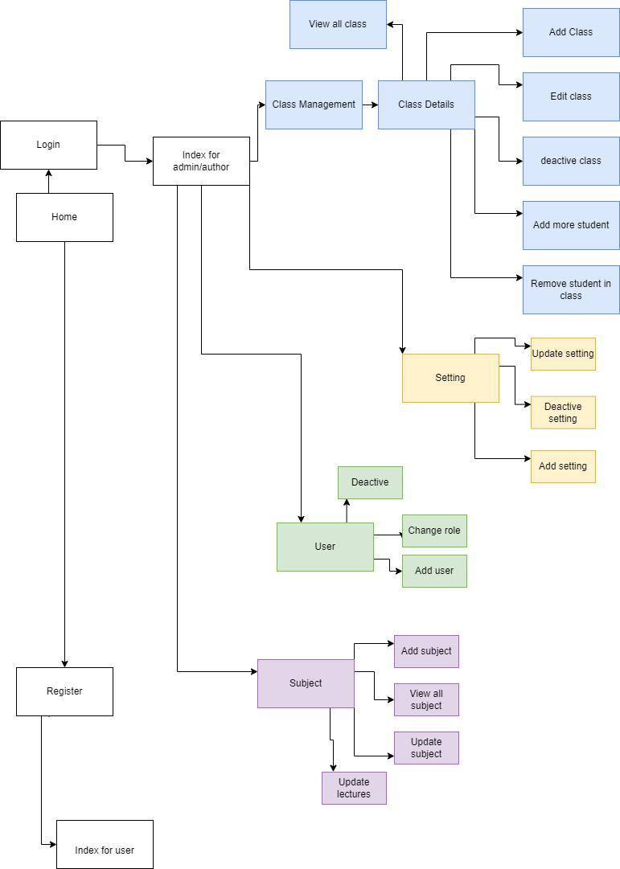
Screen flow
When a user login into the system, the system will check if his account is admin or not. If they are admin, they have permission to do something special with data like: class data, subject data,… They can see details and change anything on this function role.

Slide 11
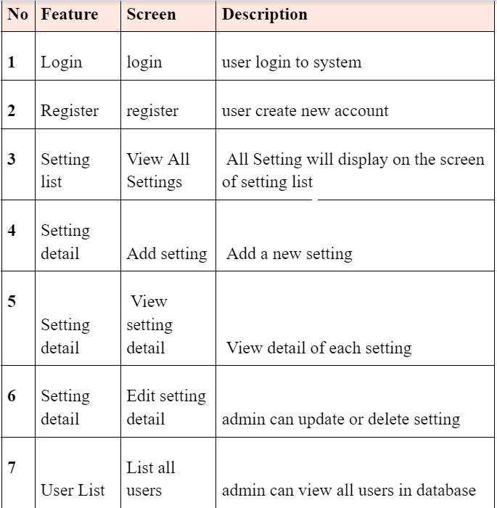
Screen desciption

Slide 12
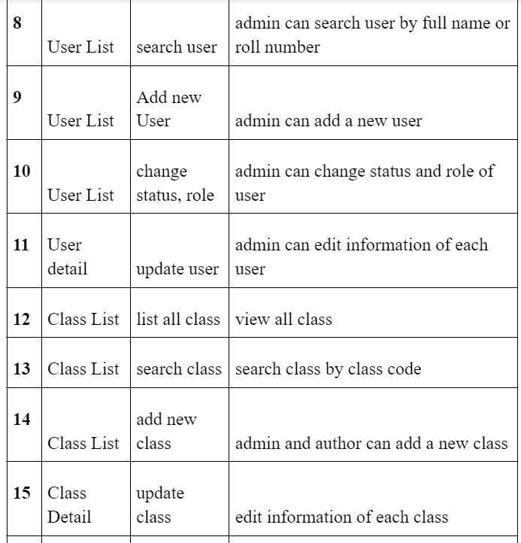
Screen desciption

Slide 13
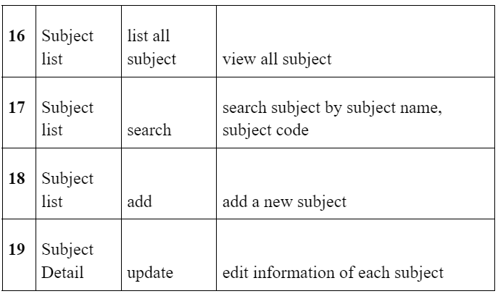
Screen desciption

Slide 14
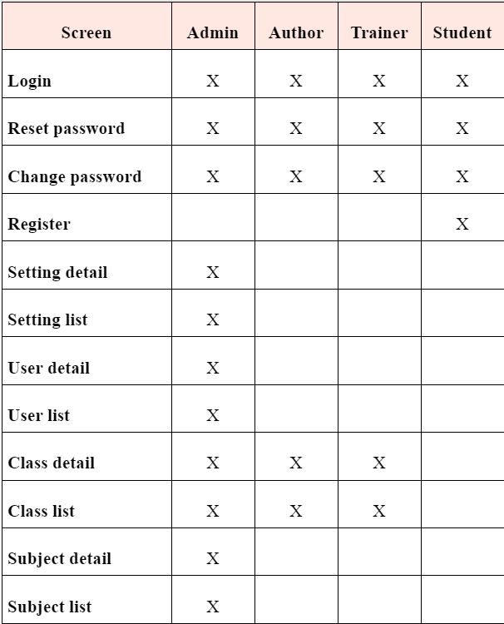
Screen authorization

Slide 15
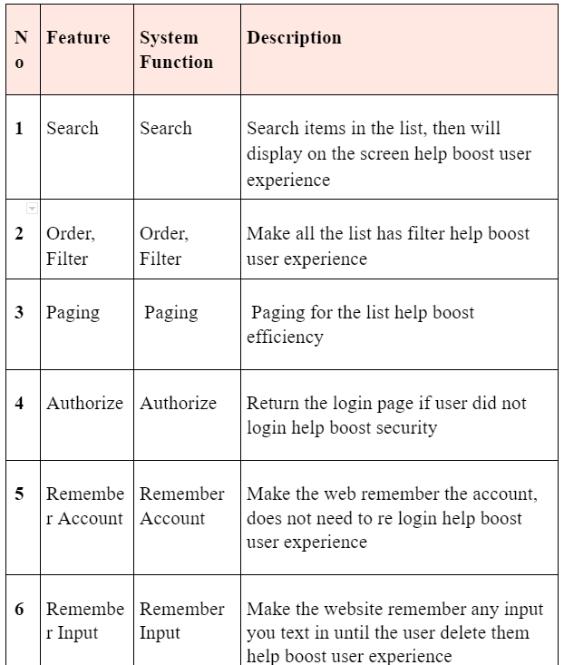
Non-Screen Functions

Slide 16
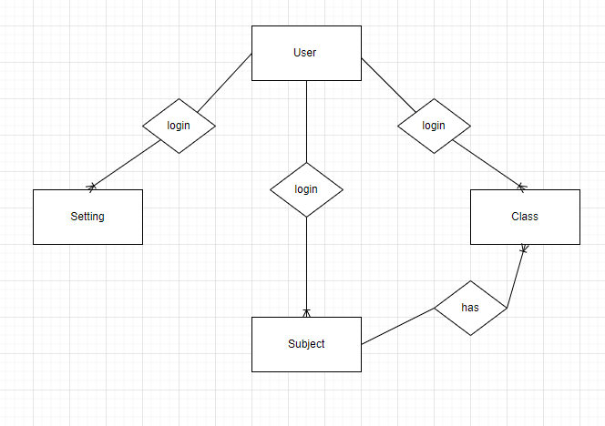
Entity Relationship Diagram

Slide 17
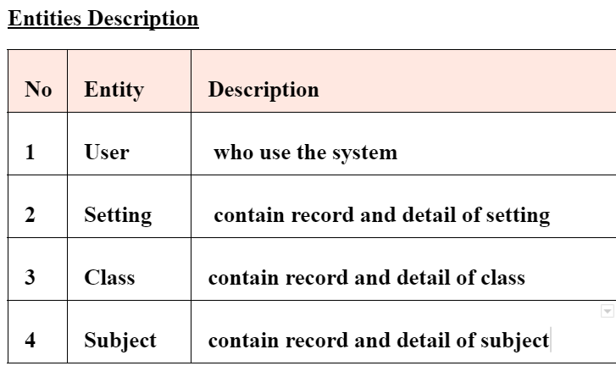
Entities Description

Slide 18

Login and register

Slide 19
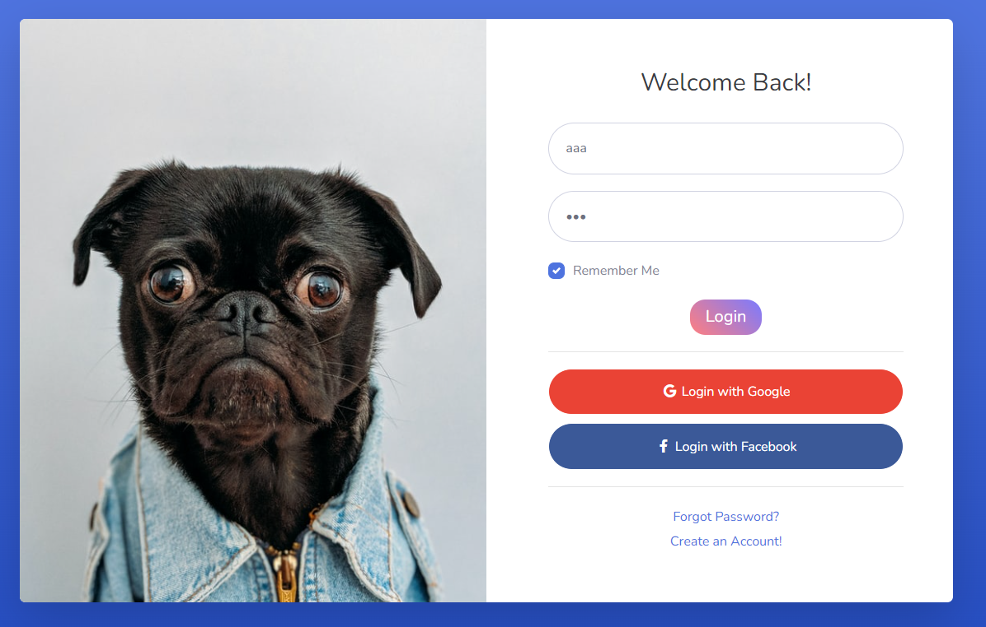
Login
Function trigger: When the users accessed the system and clicked the “Login” in the home page.
Function description: Allow user use functions in the system.
Function detail: User login into the system to use functions inside the system.
Screen layout:

Slide 20
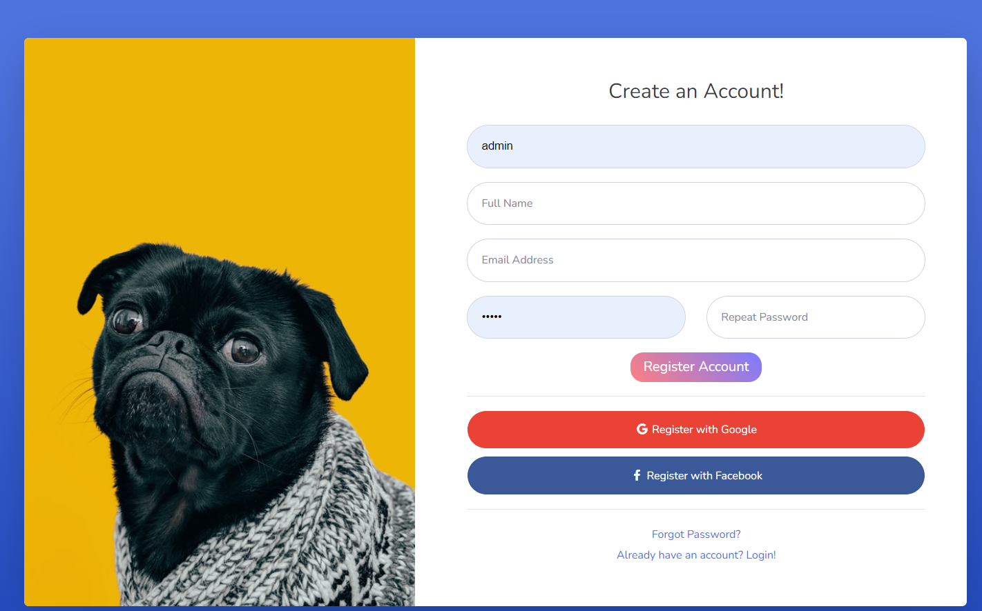
Register
Function trigger: When the users accessed the system and clicked the “Register” in the Login page.
Function description: Allows the user to create a new account to access the system.
Function detail: User will fill in the fields of form to create a new account.
Screen layout:

Slide 21
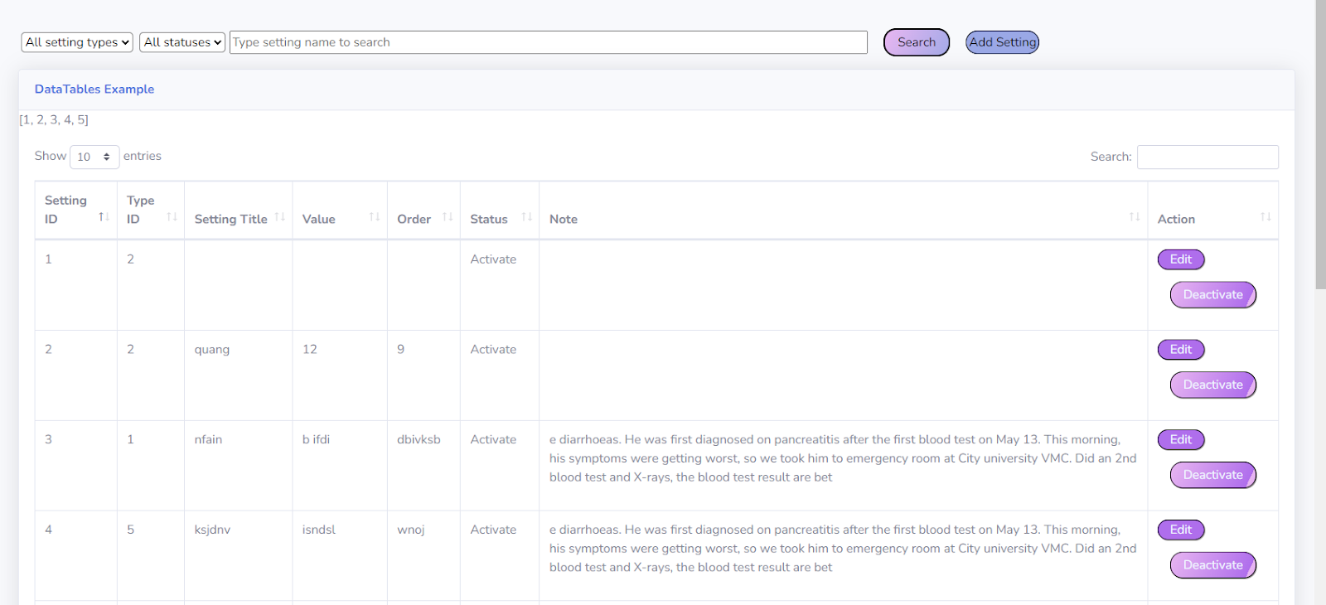
Setting
Function trigger: When user add, update or delete a record
Function description: admin will access the system to add, update or delete
Function Details:
List all settings
add setting
update setting
delete setting
search setting
Screen layout:

Slide 22
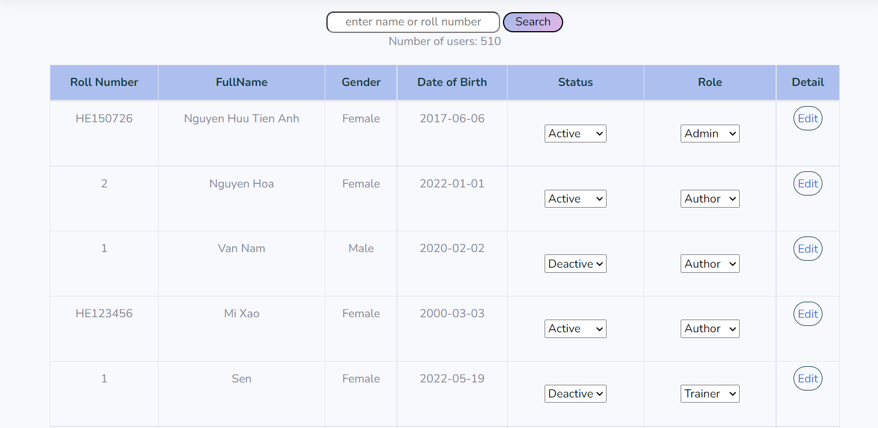
User list and detail
Function trigger: when the admin accesses the system and clicks the “User Management” in the home page.
Function description: Function is where admin can manage users access to the system. Admin can view all, search, delete and update each user.
Function detail:
Admin can view all users
Admin can search user by full name or roll number
Admin can deactivate user
Admin can update information of each user
Admin can add new user

Slide 23
Class list and detail
Function trigger: When admin access to the website, the system will show a box to access to class management
Function description: A function where the admin can work with important data like class, user,... Normal users cannot access here to make changes. If they try to do so, the system will throw an error page and request the user come back to the homepage after a few seconds.
Function Details:
Admin can see all the classes in school
Each class has a detail button to see more detail in class (students…)
Admin can manage all class
admin can add more student in class
admin can remove (kick) student in class

Slide 24
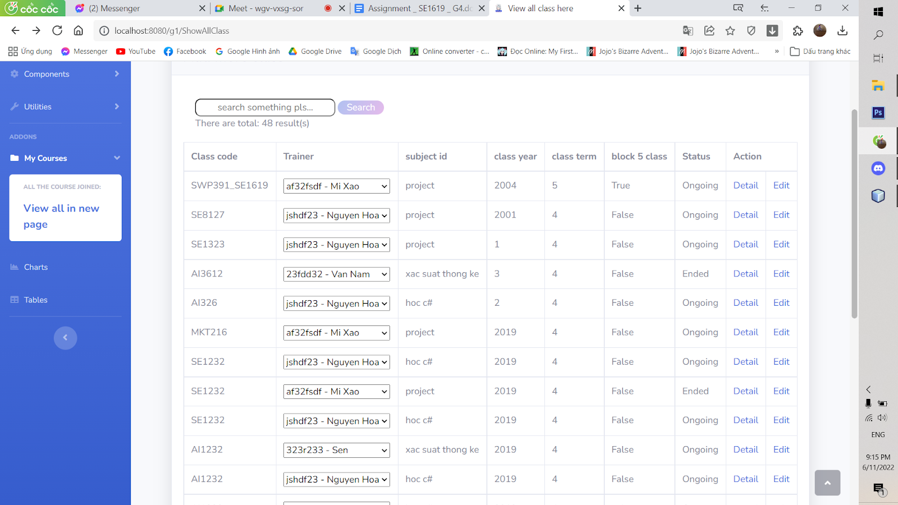
Class list and detail
Screen layout: It connects to the page home for admin to help admin change the information on this function.

Slide 25

Subject list and detail
Function trigger: The user requests to see the list of subjects when clicking the button to view the list of subjects at the dashboard
Function description:
Common users can see all the active subjects, search and follow the filter.
Admin can see all the subjects including not active subjects, also search and follow the filter.
Admin can modify the subject data like update and add new subject

Slide 26
Subject list and detail
Function Details:
Common users just see all the classes of subjects that were activated. They also have any function of filter like search, order subject and paging
Admin can see all the list of subjects including those that are not active. This helps the admin to easily update and edit the subjects.
When the admin clicks on add a new subject, the system will display a table and ask the admin to enter the full information of the subject. If the admin input is valid, the system requirements are satisfied. The system will add a new subject to the class list and a message will appear indicating that the subject has been successfully added. If the admin's input values are not valid, the system will send a warning corresponding to the reason why the subject cannot be added and ask the admin to re-enter the subject information.
When the admin clicks on the subject update, the system will open a table to help the admin edit the selected subject for editing. Similar to how the admin adds a new subject, but when the admin enters it correctly, the system will replace the selected subject information with the new information that the admin has just entered.

Slide 27
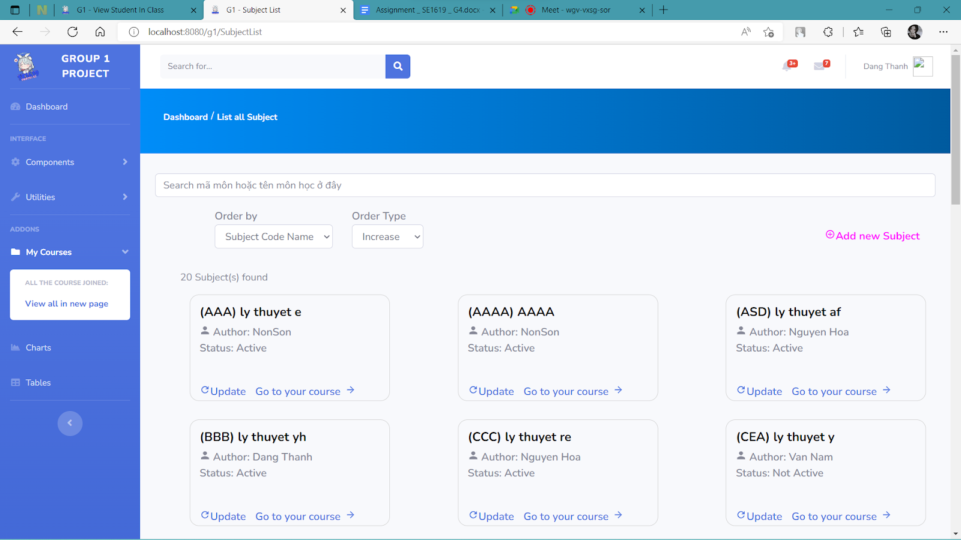
Subject list and detail
Screen layout:

Slide 28
THANKS FOR WATCHING

